Slide 1

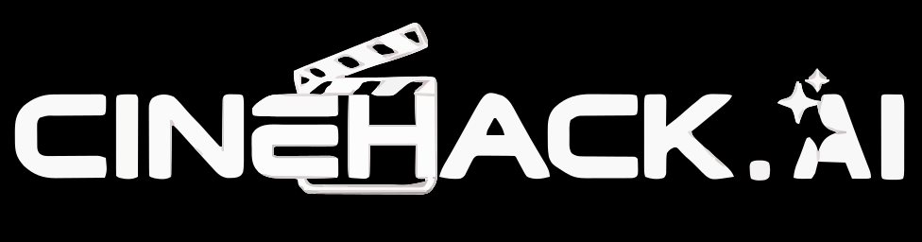
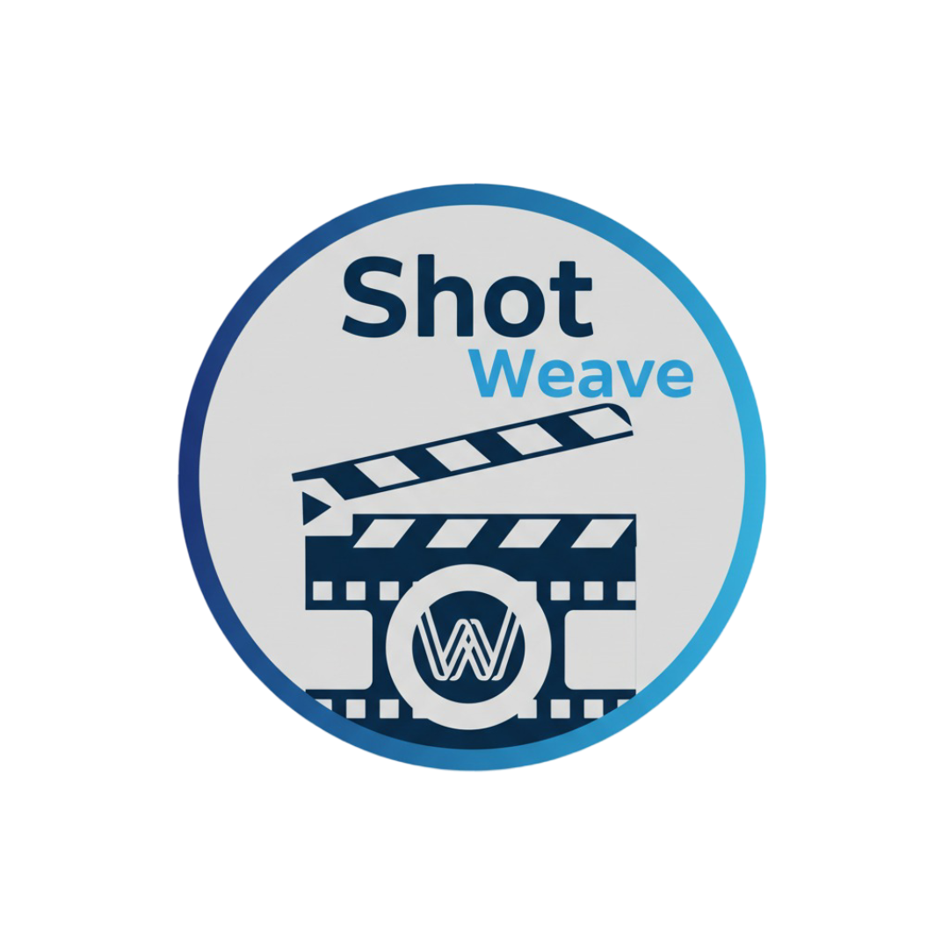
Shotweave
An AI-Powered Production OS for the Film Industry
Team: The Final Cut
CineHack.ai 2025

Slide 2
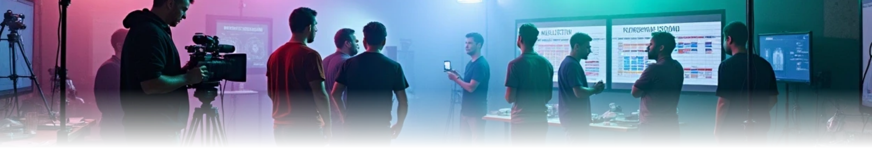


Introduction
Shotweave is a smart production management tool that streamlines filmmaking from pre-production to post-production. It enables teams to plan, collaborate, and manage projects efficiently using AI-assisted insights, unified communication, and a centralized dashboard. With Shotweave, filmmakers can reduce planning time by 40%, cut production costs by 25%, and make data-driven decisions for smoother project execution.

Slide 3
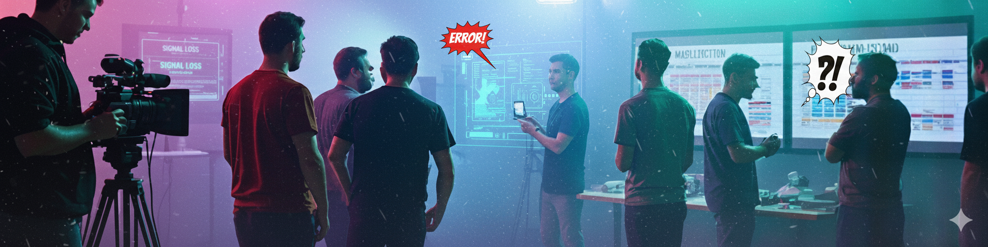

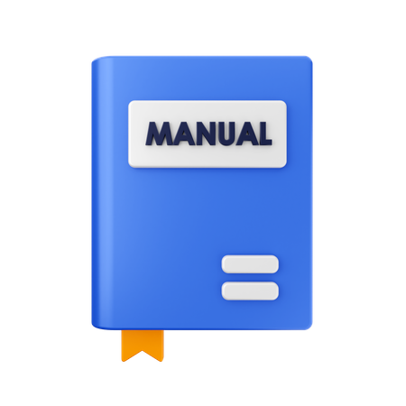

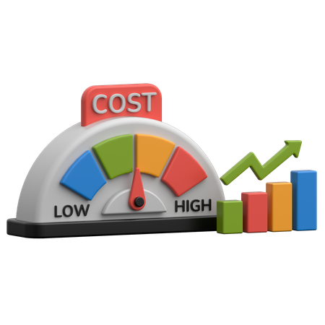

Problems and Blind Spot
Regional film industries struggle with fragmented workflows:
1
2
Manual scheduling & crew coordination slows production.
Poor vendor communication causes delays.
3
4
Budget overruns happen due to lack of predictive insights.
No unified platform to manage the entire production.

Slide 4








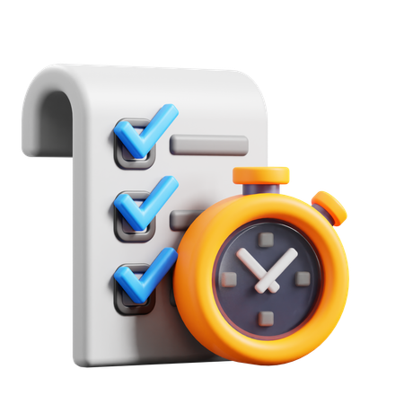
Key Features
Script Breakdown AI
Smart Scheduling Assistant
Predictive Budget Estimator
• Helps break your script into scenes, characters, props, and locations automatically.
• Makes shooting schedules quickly, based on actor availability and location.
• Tells you how much your production will cost so you can plan your budget.
Vendor & Crew Recommendation Engine
Real-time Production Tracking
Cloud Collaboration Dashboard
• Shows what’s happening on set in real time.
• Suggests the best vendors and crew members for your project.
• Keeps everyone on the same page with files and updates in one place.

Slide 5
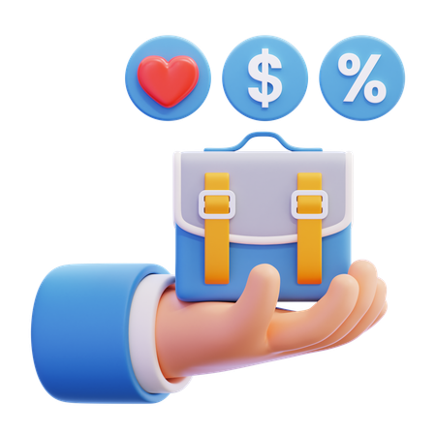



Impacts & Benefits
We empower regional filmmakers with
tools that use data to guide decisions.
Project planning is 40% faster using
our tools.
All stages of production have unified
communication.
AI insights help reduce costs by 25%.

Slide 6


System Overview
ShotWeave is an AI-powered Production Operating System designed for the film industry. It streamlines pre-production, production, and post-production workflows, helping filmmakers make data-driven decisions, save time, and optimize resources. Develop a comprehensive AI-powered dashboard that unifies all aspects of film production within a single integrated platform. The system encompasses pre-production planning, active production monitoring, post-production workflows, and distribution management. Key features include:
Centralized finance management.
Real-time operations tracking.
HR coordination.
Administrative task automation.
Design workflow optimization.
VFX pipeline management.
Dynamic reporting capabilities.
Intelligent budget oversight with predictive analytics for cost control and resource allocation.

Slide 7
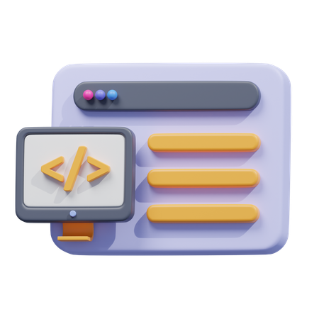

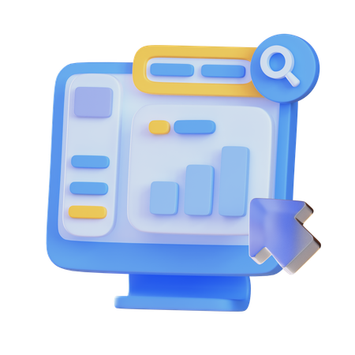

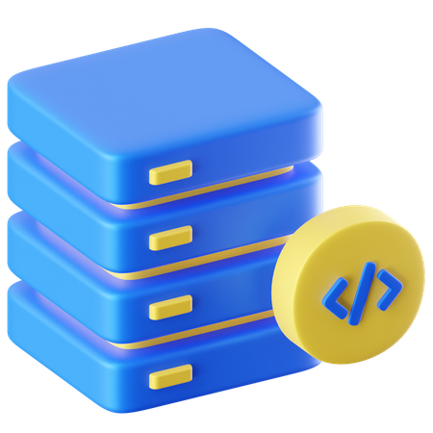




Tech Stack
1
Frontend
2
Backend
3
Database
4
AI/ML
5
Deployment
• React.js (for dashboard) or plain HTML/CSS if time is less.
• Python Flask API
(faster for AI).
• MongoDB (for storing dummy tasks/progress).
• Python (Spacy for Script break-down)
scikit-learn for regression, simple & hackathon friendly).
• Vercel

Slide 8
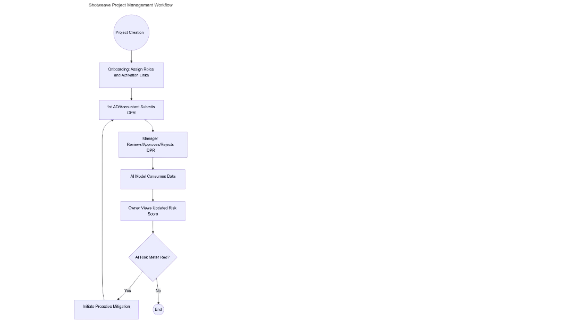

Architecture
User Work Flow Design

Slide 9



